Slide 1
PROJECT TITLE
CAPSTONE PROJECT
Presented By:
Student Name : PRIYANSHU RAJ SINGH
College Name & Department : VARDHAMAN COLEGE OF ENGINEERING ( COMPUTER SCIENCE AND ENGINEERING )

Slide 2
OUTLINE
Problem Statement
Technology used
Wow factor
End users
Result
Conclusion
Git-hub Link
Future scope

Slide 3
Problem Statement
EncryptDecryptify tackles evolving data security threats by offering versatile encryption (AES, RSA, ECC, ChaCha20) for text, media, and communications. Prioritizing accessibility and quantum resistance, it combines robust algorithms, user-friendly tools, and post-quantum cryptography to safeguard against cyberattacks and future quantum risks, ensuring adaptable protection for diverse user needs.

Slide 4
Technology used
LIBRARIES :
Frontend
HTML: Markup language for creating the structure of the web pages.
CSS (Tailwind CSS): Utility-first CSS framework for designing responsive and modern user interfaces.
JavaScript: Implemented core logic and interactivity.
Cryptography Library: Enabled AES, RSA, ECC, and ChaCha20 encryption (e.g., Web Crypto API or crypto-js).
PLATFORMS :
VS CODE
GITHUB

Slide 5
Wow factors
1. AES (Advanced Encryption Standard): This is the standard encryption method used by the U.S. government and is widely adopted globally for securing sensitive data.
2. RSA (Rivest-Shamir-Adleman): One of the first public-key cryptosystems, RSA is extensively used for secure data transmission and digital signatures.
3. Blowfish: While not as commonly used today as AES, Blowfish was popular in the 1990s and is still recognized for its speed and effectiveness.
4. Twofish: This algorithm was a finalist in the AES competition and is known for its security and performance, though it is less commonly used than AES.
5. ECC (Elliptic Curve Cryptography): ECC is gaining popularity due to its efficiency and strong security with smaller key sizes, making it suitable for mobile and embedded systems.
6. ChaCha20: This stream cipher is well-regarded for its performance and security, especially in mobile applications and is used in protocols like TLS.
7. Salsa20: Similar to ChaCha20, Salsa20 is recognized for its speed and security, though ChaCha20 has largely supplanted it in modern applications.
8. Homomorphic Encryption: While still an area of active research, it is gaining attention for its potential applications in privacy-preserving computations, especially in cloud computing.
9. Post-Quantum Cryptography: As quantum computing advances, this field is becoming increasingly important, and many organizations are exploring these algorithms to future-proof their security.
10. Quantum Key Distribution (QKD): This is a cutting-edge area of research that is gaining traction for its potential to provide secure communication channels.

Slide 6
End users
Individuals 🔒: Securing personal files, messages, and digital privacy.
Businesses 💼: Protecting financial data, intellectual property, and client communications.
Developers 👩💻: Integrating encryption into apps/systems; testing experimental algorithms.
Government/Defense 🛡️: Safeguarding classified data and national security operations.
Healthcare/Legal Sectors ⚖️: Ensuring confidentiality of medical records and legal documents.
Researchers 🧪: Exploring post-quantum, homomorphic, and quantum-based encryption.

Slide 7
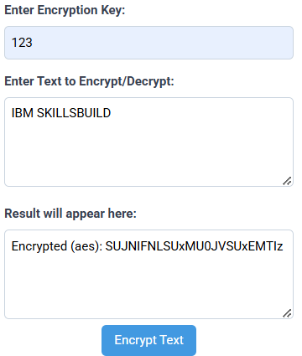
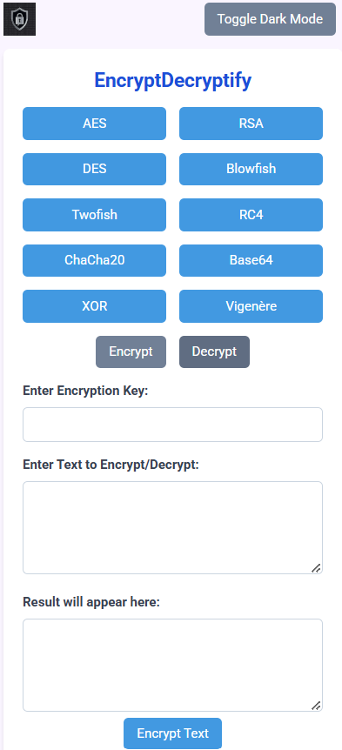
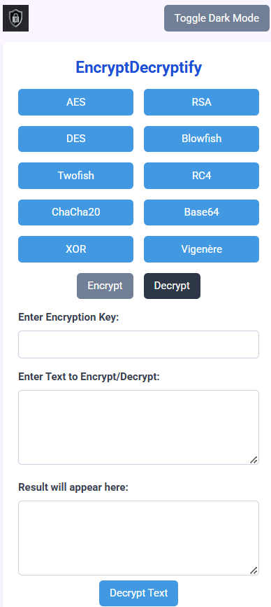
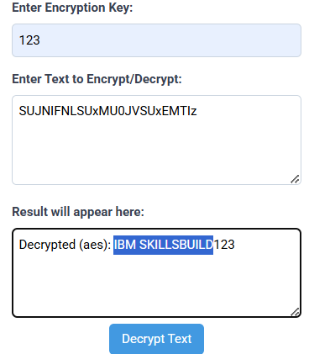
Results
USE OF ( AES ) →

Slide 8
Conclusion
EncryptDecryptify empowers users with versatile, user-friendly encryption tools to safeguard data against modern threats. By combining robust algorithms (AES, ECC, ChaCha20), quantum-resistant research, and accessibility, it bridges the gap between security and usability, ensuring protection for individuals, businesses, and institutions in an evolving digital landscape.

Slide 9
GitHub Link
Live Website URL: https://priyanshu-rajsingh.github.io/EncryptDecryptify.github.io/
GitHub Repository URL:https://github.com/Priyanshu-rajsingh/EncryptDecryptify.github.io

Slide 10
Future scope(optional)
Expand Post-Quantum Algorithms: Integrate NIST-approved standards (e.g., CRYSTALS-Kyber) for quantum-proof security.
Enhanced Homomorphic Encryption: Optimize for real-world use in cloud computing and privacy-preserving analytics.
Cross-Platform Support: Develop mobile/desktop apps and browser extensions for seamless encryption.
AI-Driven Threat Detection: Pair encryption with machine learning to identify vulnerabilities or breaches.
IoT Integration: Secure low-power devices (sensors, smart home tech) with lightweight encryption.
Global Compliance Tools: Auto-update features to align with regional data laws (GDPR, CCPA, etc.).
Collaborative Security: Enable secure multi-user workflows (e.g., encrypted team document editing).
Quantum Key Distribution (QKD): Pilot partnerships for real-world QKD implementation in critical sectors.

Slide 11
THANK YOU

